Slide 1

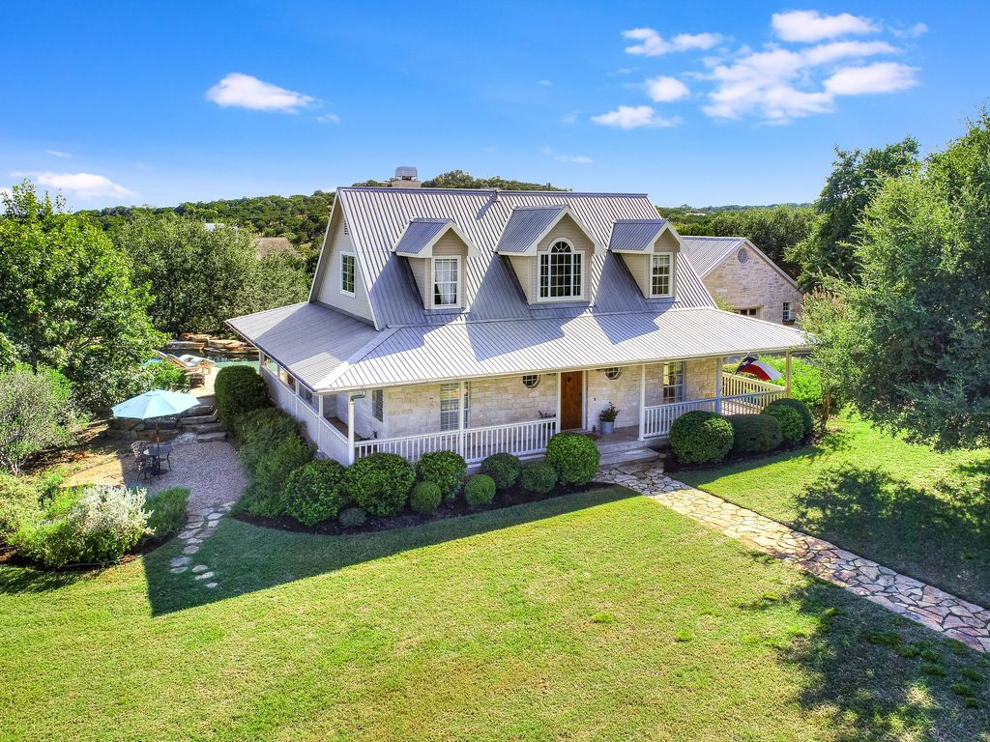
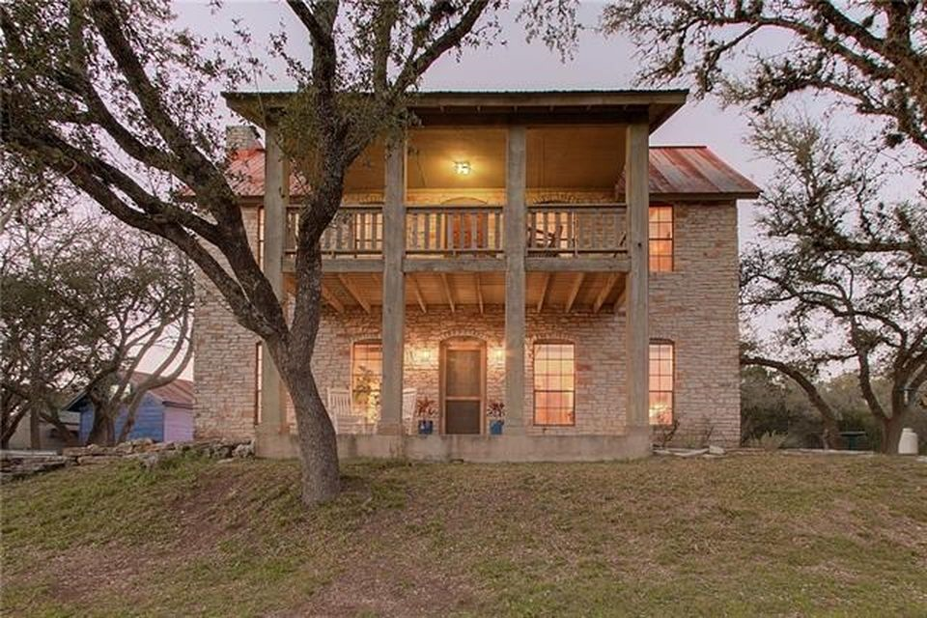
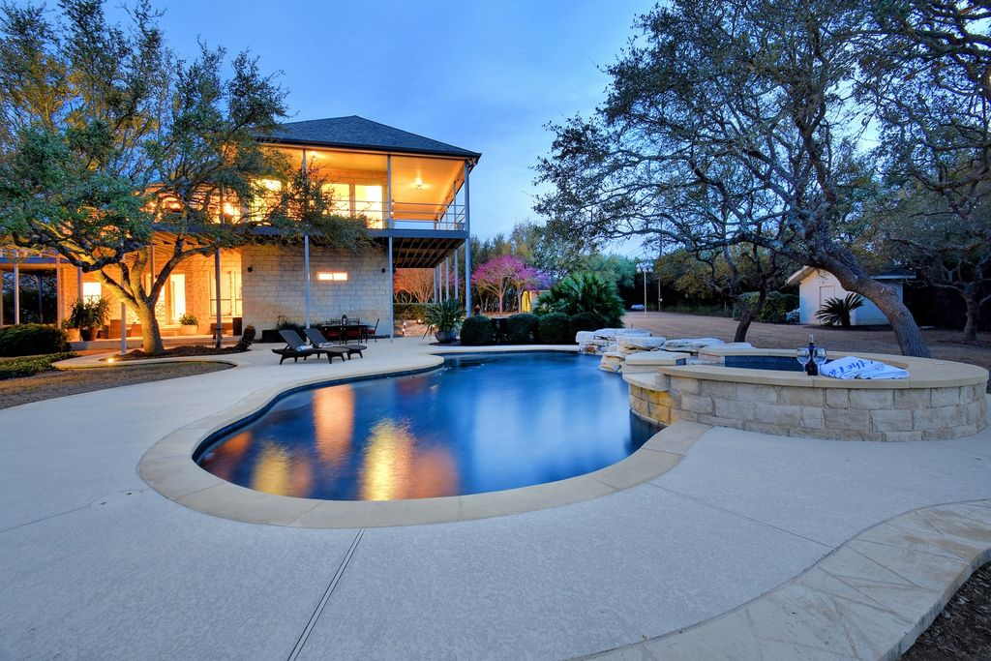
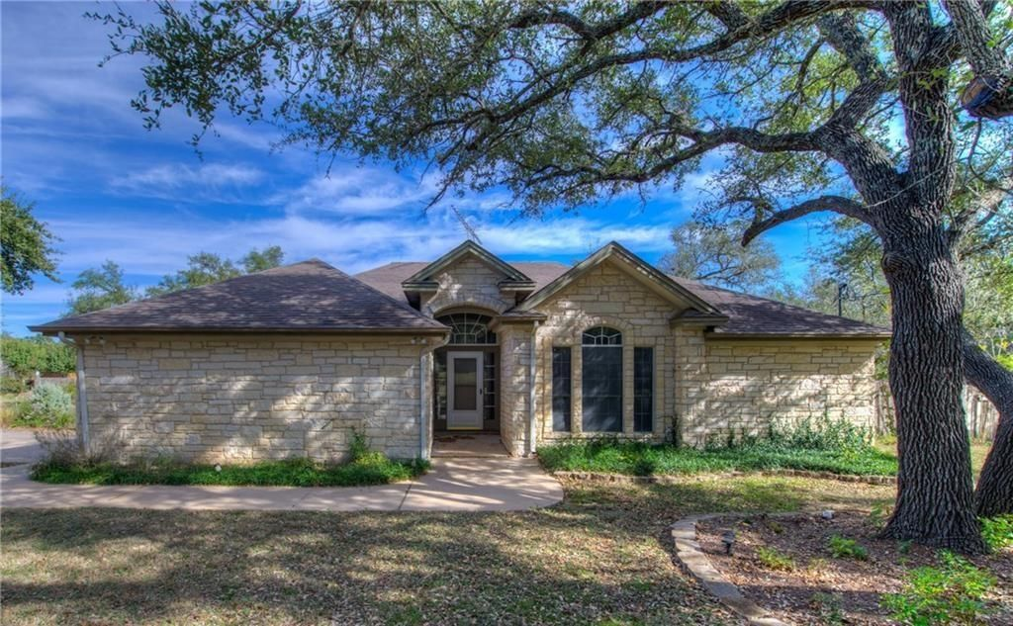
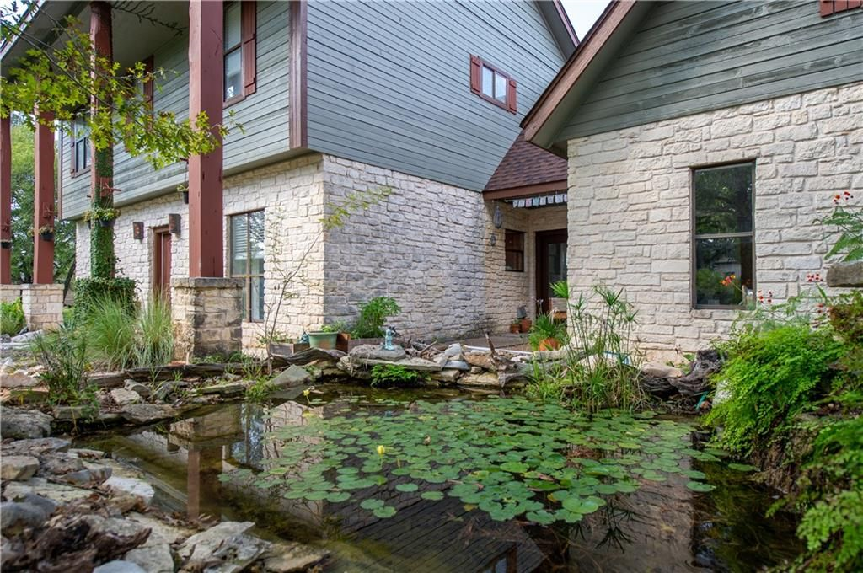
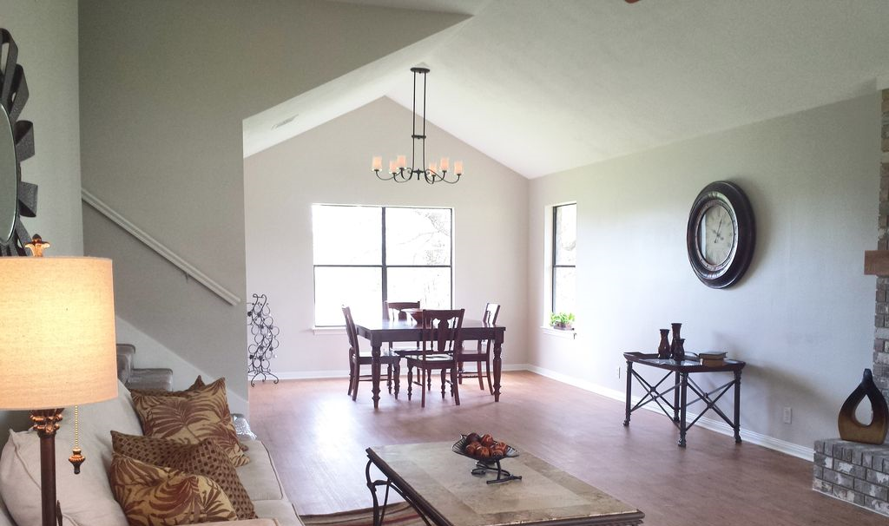
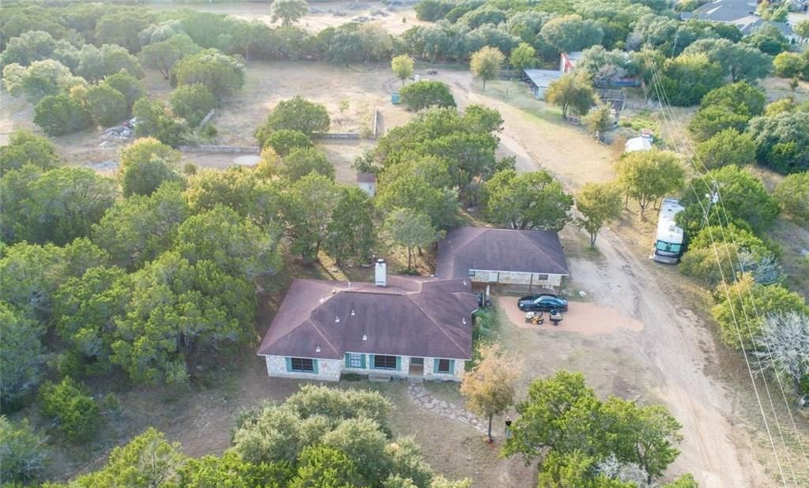
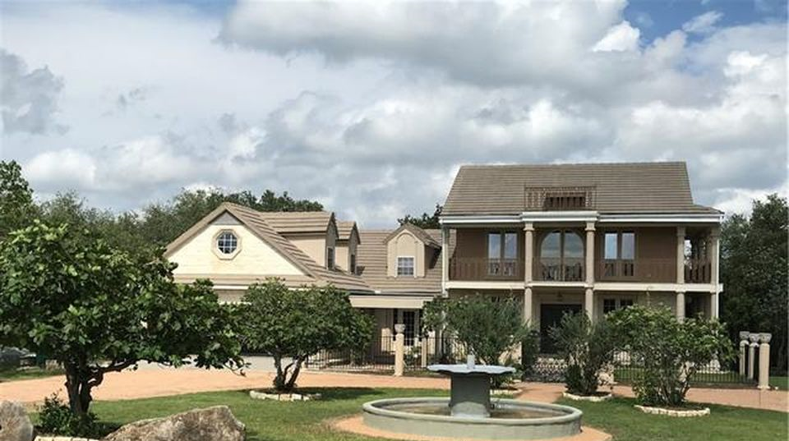
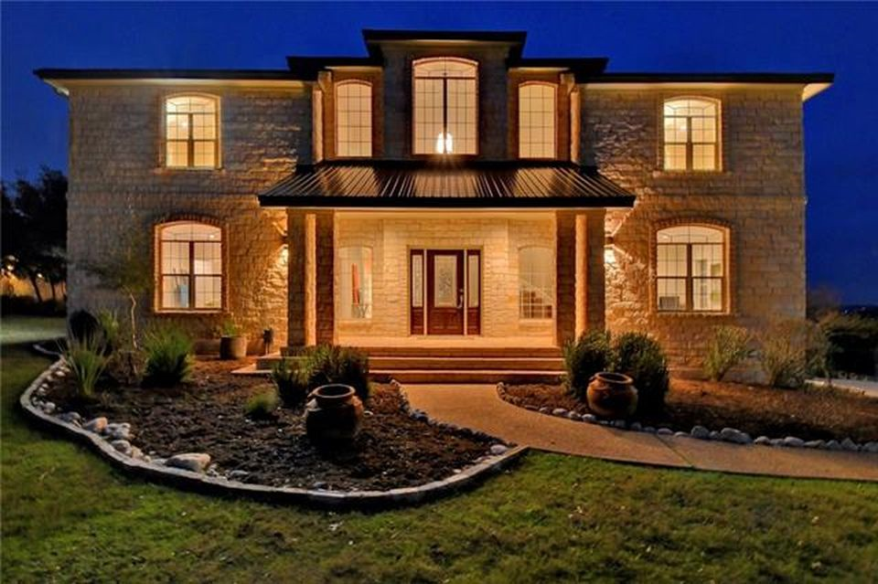
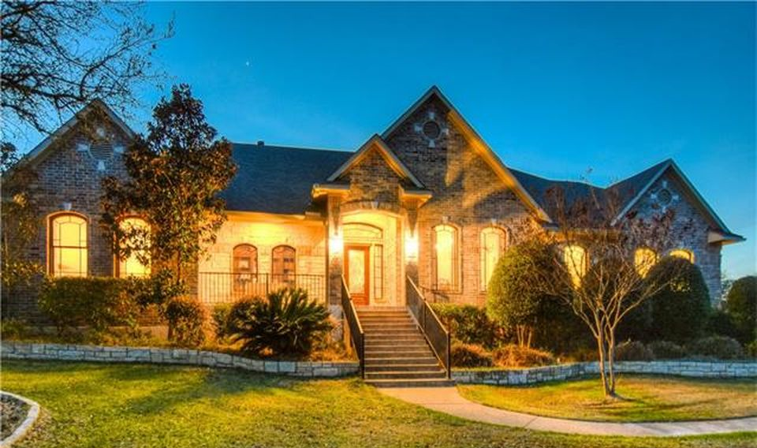
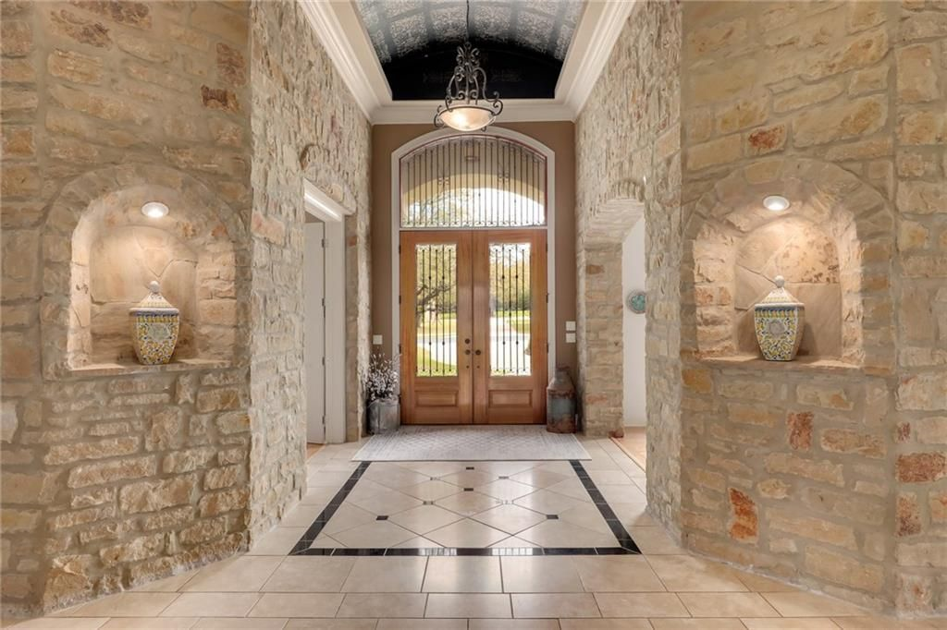
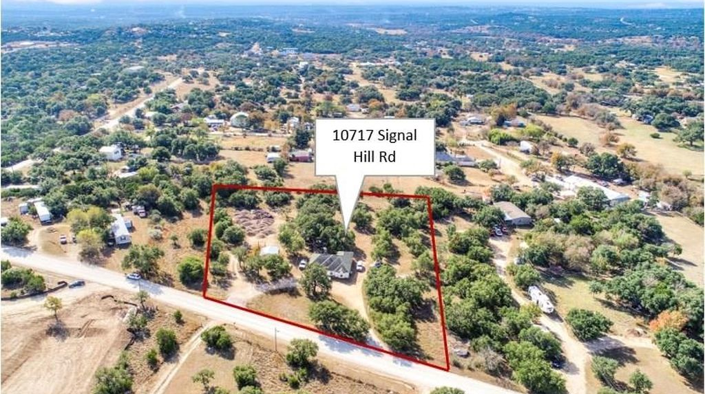
Austin, TX - House Listings
DATA ANALYSIS OF THE HOUSING MARKET
Prepared by: Nina Sysoeva

Slide 2


Meet Jen, The Data Science Fan
Lives in Austin, Texas
Has been working as a realtor for the past decade
Specializes in residential real estate
Recently became fascinated with data science
Notes:
Not your typical millennial. Has 10 years of experience as a realtor. Works at a firm out of Texas.

Slide 3
Meet Jen, The Data Science Fan
Background: no BrainStation campus in Texas (& not keen on online studies)
Problem Statement: Asked us to investigate whether there is a data science solution available to help Jen & her team with pricing houses more effectively

Slide 4
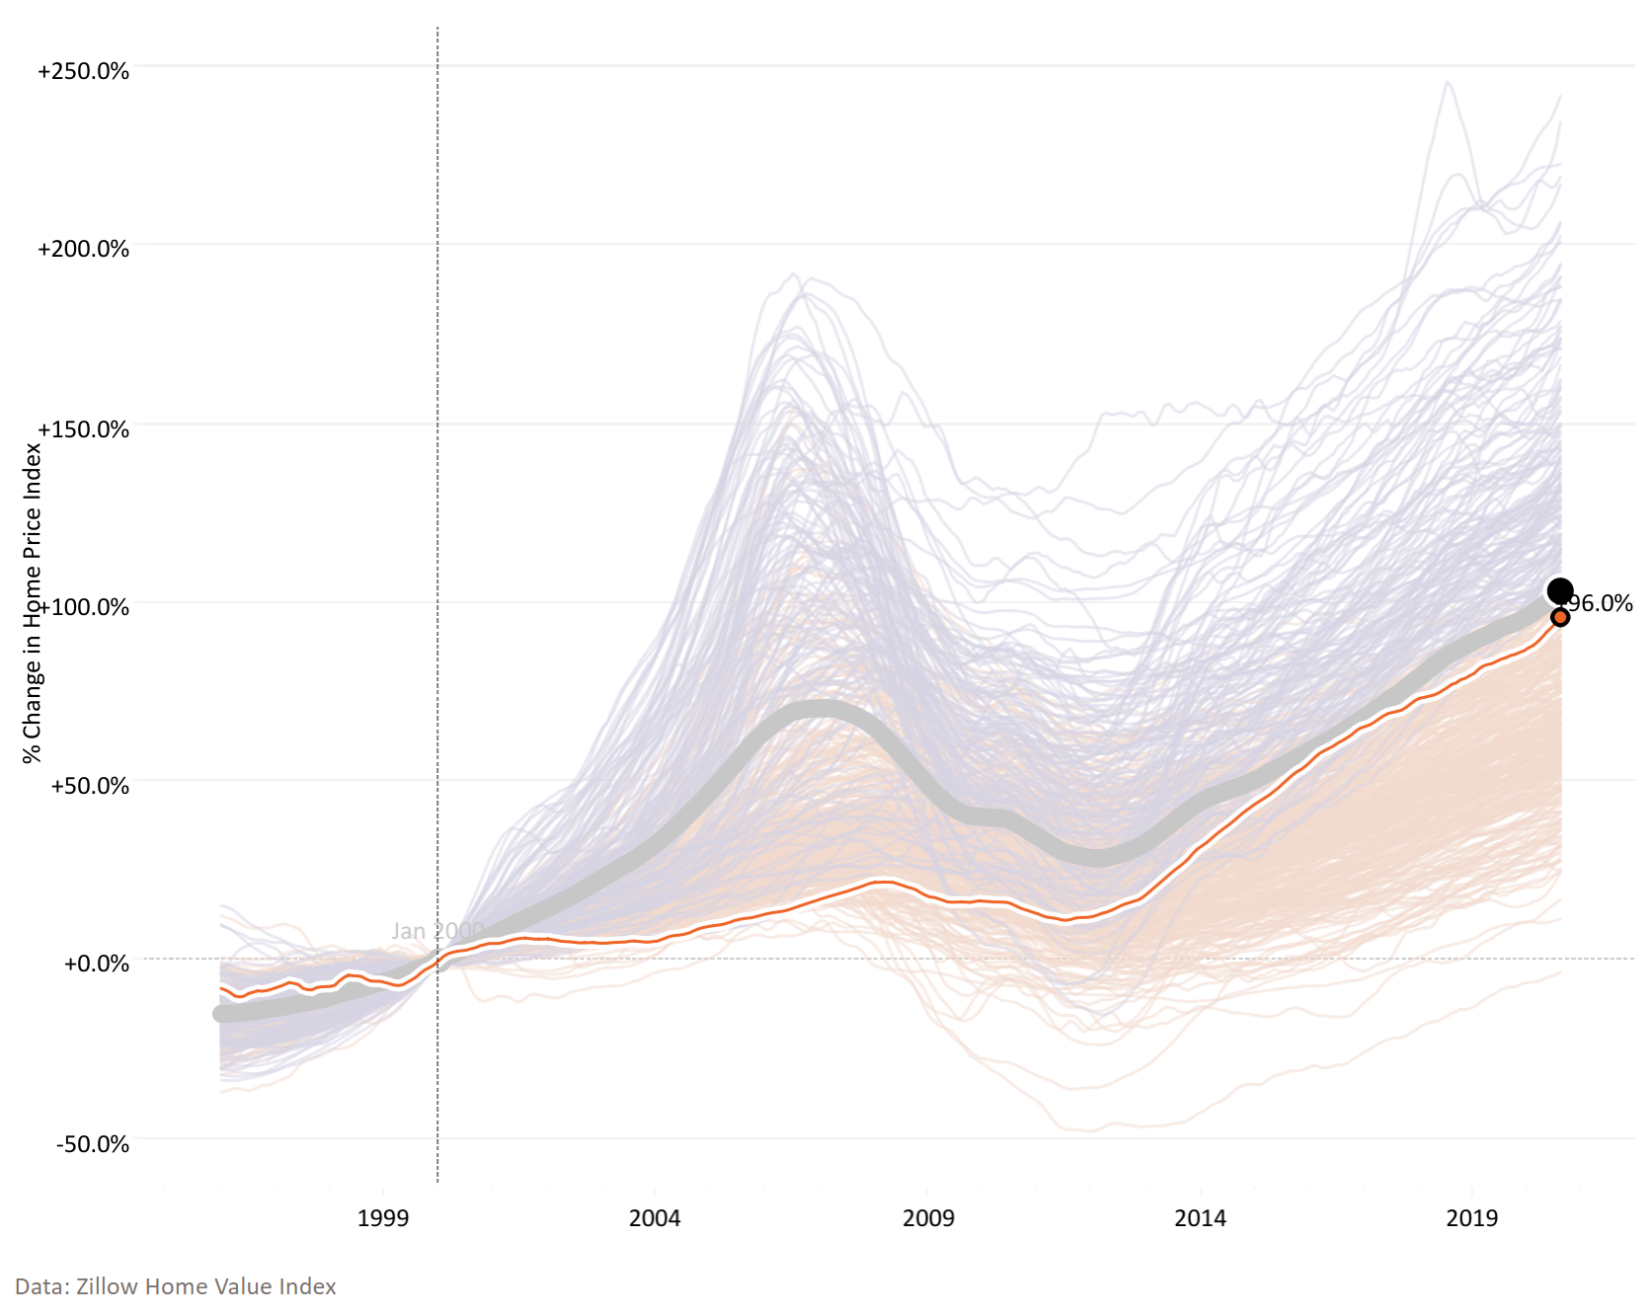
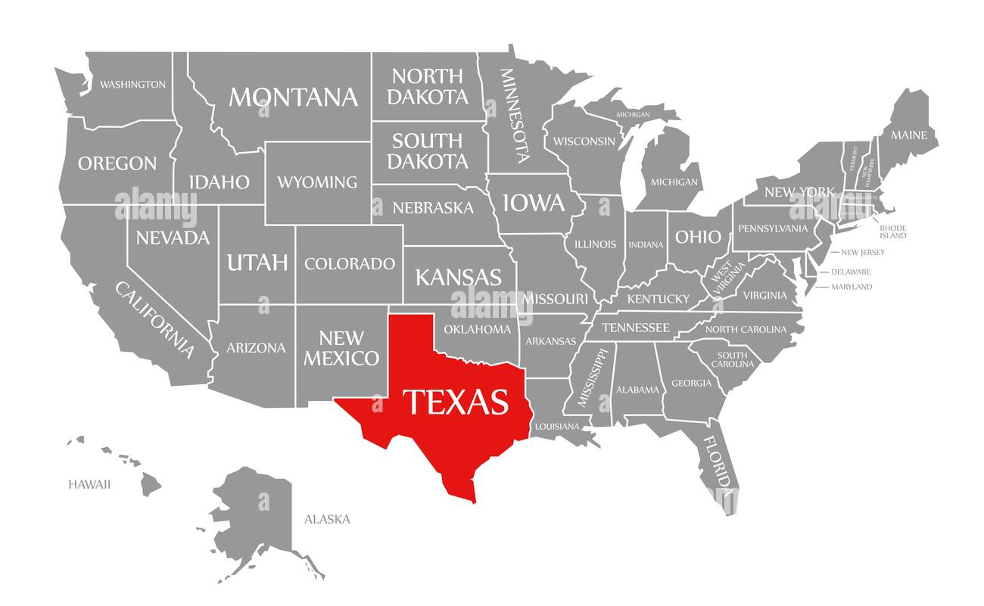
Austin 20-Year Home Price Index Growth Is Comparable to the U.S. Average
Home Price Index Change Across U.S. Metro Areas: Jan 2000 – Aug 2020
 | Austin, TX | U.S. Avg.
Difference Jan 2000 – Aug 2020 | +96% | +103%
Home Price Index (Aug 2020) | $357k | $257k
U.S. Avg.
Austin, TX
Dataset was scraped as of Jan 2021
https://www.visualcapitalist.com/20-years-of-home-price-changes-in-every-u-s-city/
Notes:
Jen knows the housing market in Texas very well
To set the stage, she shared the U.S. home price index with us.
Home Price Index = average home value (single-family home)
We are looking at prices from 2000 up until 2020
Austin 20-Year Home Price Index Growth Is Comparable to the U.S. Average
First, the trajectory of home prices is defined by the 2008 Financial Crisis. After prices took a steep dive, it took a full decade for the average home price to rise back up to the 2007 peak.

Slide 5
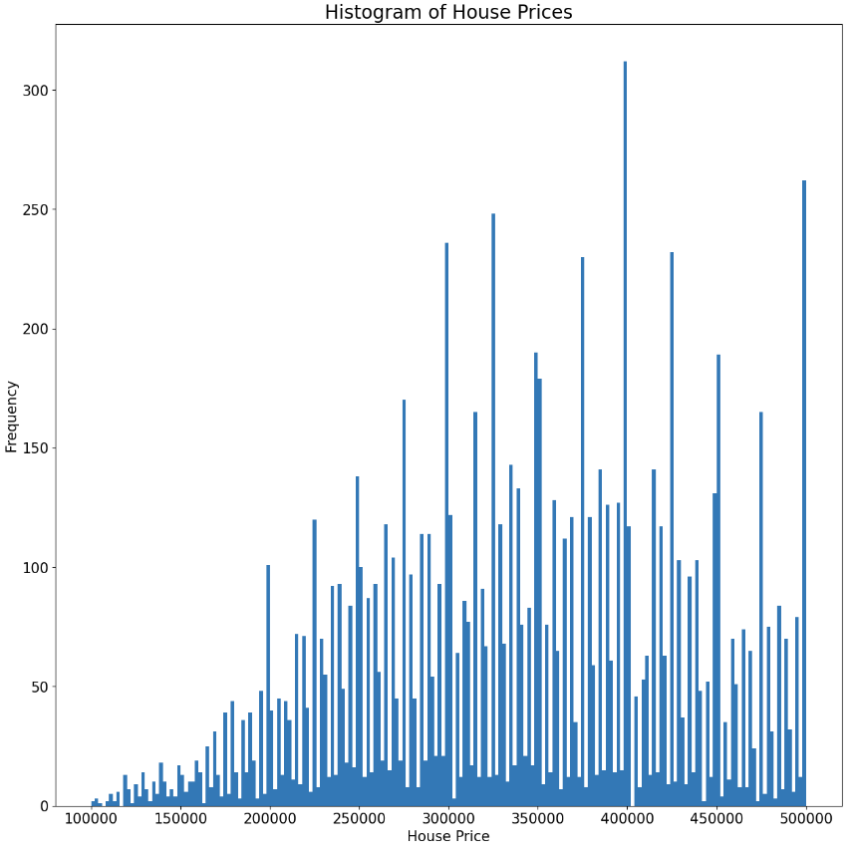
54 Independent Features Used; Optionality to Remove Outliers Based on Price Assessed
54 Independent Features Used in the Analysis
latitude | numOfParkingFeatures | numOfStories
longitude | numOfPatioAndPorchFeatures | city_del valle
propertyTaxRate | numOfSecurityFeatures | city_driftwood
garageSpaces | numOfWaterfrontFeatures | city_dripping springs
hasAssociation | numOfWindowFeatures | city_manchaca
hasCooling | numOfCommunityFeatures | city_manor
hasGarage | lotSizeSqFt | city_pflugerville
hasHeating | livingAreaSqFt | city_road
hasSpa | numOfPrimarySchools | city_west lake hills
hasView | numOfElementarySchools | homeType_Condo
parkingSpaces | numOfMiddleSchools | homeType_Mobile / Manufactured
yearBuilt | numOfHighSchools | homeType_MultiFamily
numPriceChanges | avgSchoolDistance | homeType_Multiple Occupancy
latest_salemonth | avgSchoolRating | homeType_Other
latest_saleyear | avgSchoolSize | homeType_Residential
numOfPhotos | MedianStudentsPerTeacher | homeType_Single Family
numOfAccessibilityFeatures | numOfBathrooms | homeType_Townhouse
numOfAppliances | numOfBedrooms | homeType_Vacant Land
We will look at models both including and excluding outliers
Removing outliers: keeping House Price in $100k-$500k range
latestPrice
Notes:
Jen provided us with a dataset. 54 independent variables after some feature engineering (removing a few features and adding dummies for others)
Later in our analysis, we have revealed that our dependent variable (Price) has outliers going up to $13.5M. We have then chosen to eliminate the outliers and run some of the regression models on data which only include rows where housing prices are between $100k and $500k.

Slide 6
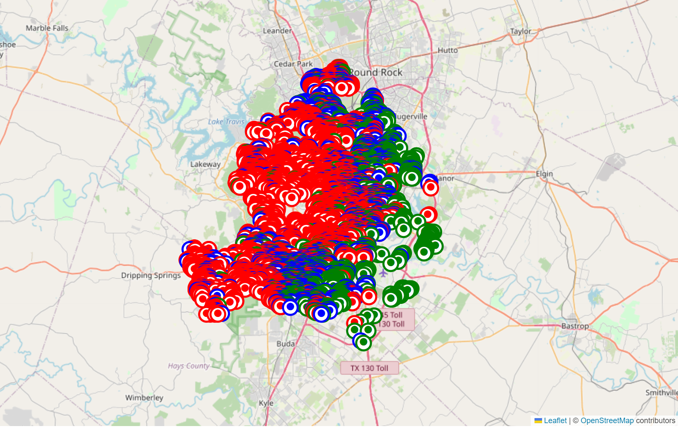

Housing Properties Clustered Around Austin Based on Their Price Bracket
12 MB
<$309k (1st Quartile)
<$405k (Median)
54 Features
after cleaning/engineering
>$405k
Austin
~15,000 Rows
Based on Zillow Listings
Notes:
- As the next step, we investigated the data further. It contained no duplicates and only a few missing values in the description column. Because the missing values were very few (2), we have removed the rows that contained them.
- Further, we have looked at the geographic map of housing properties and identified that the properties generally cluster by price, with those <$309k (1st quartile of the distribution) located on the east side of the city, those between $309k and $405k (where $405k is the median value) spread in the middle of the city, from north to south, and those >$405k located in the central and western edge of the city.

Slide 7
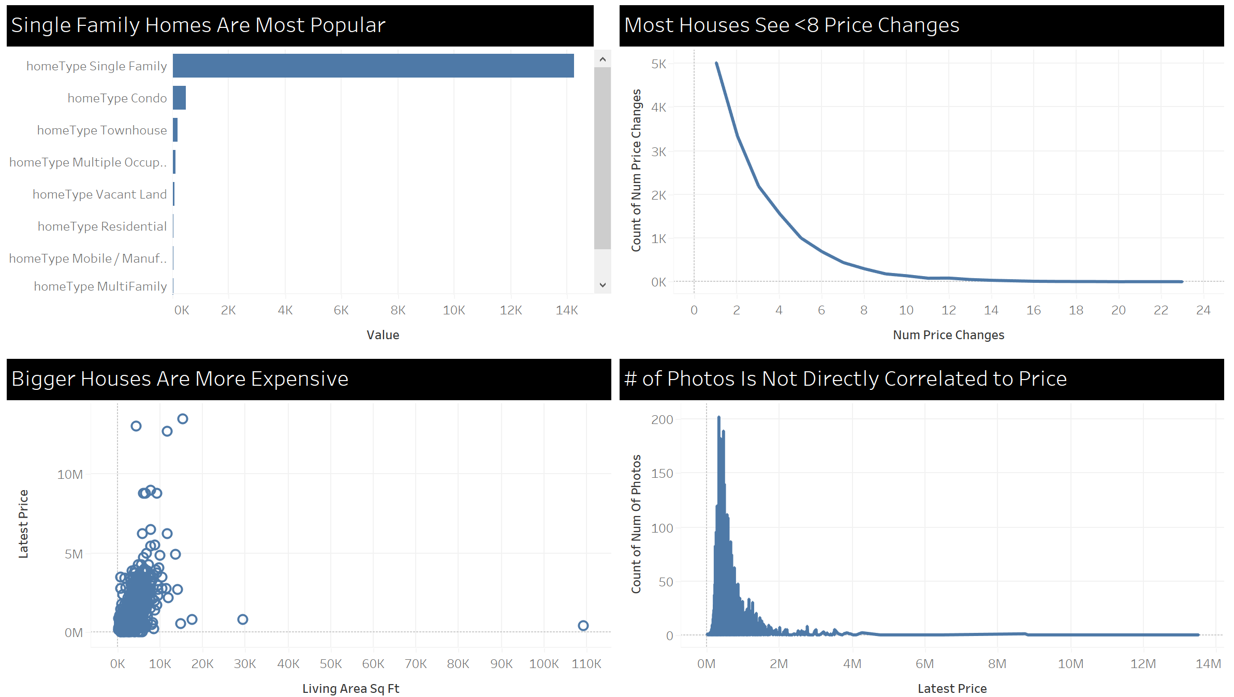
A Few High-Level Conclusions Based on Provided Features
1-8 price changes is what is seen on the market
Single Family homes - by far most popular home type (dummy variable in our analysis)
Unsurprisingly, price is not directly correlated to # of photos, although there is a relationship
However, the effect of outliers is evident

Slide 8

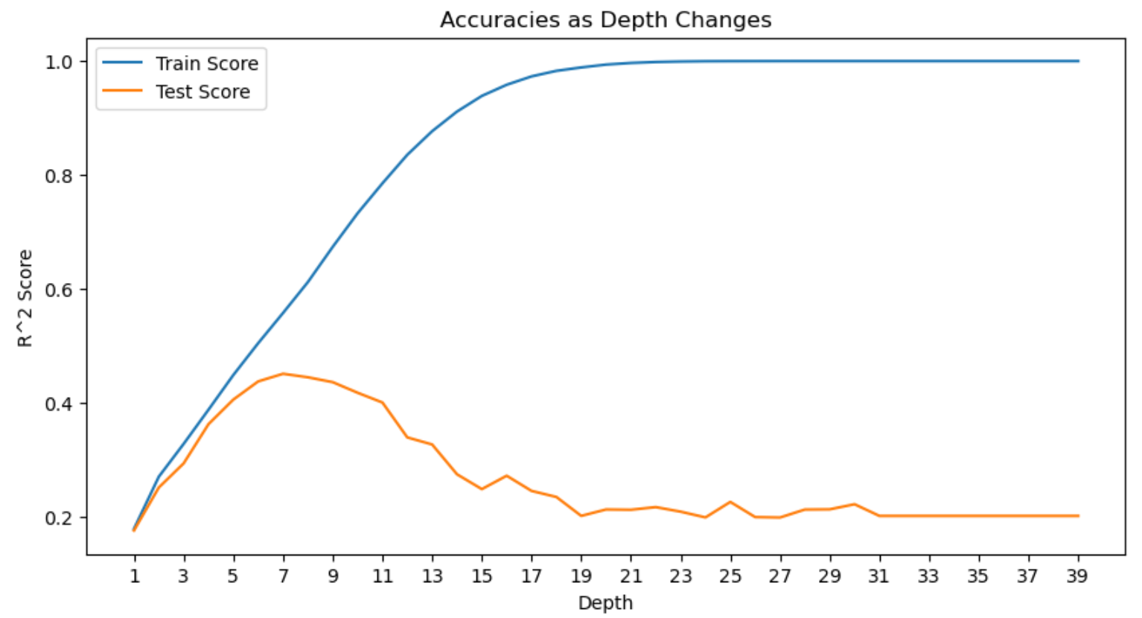
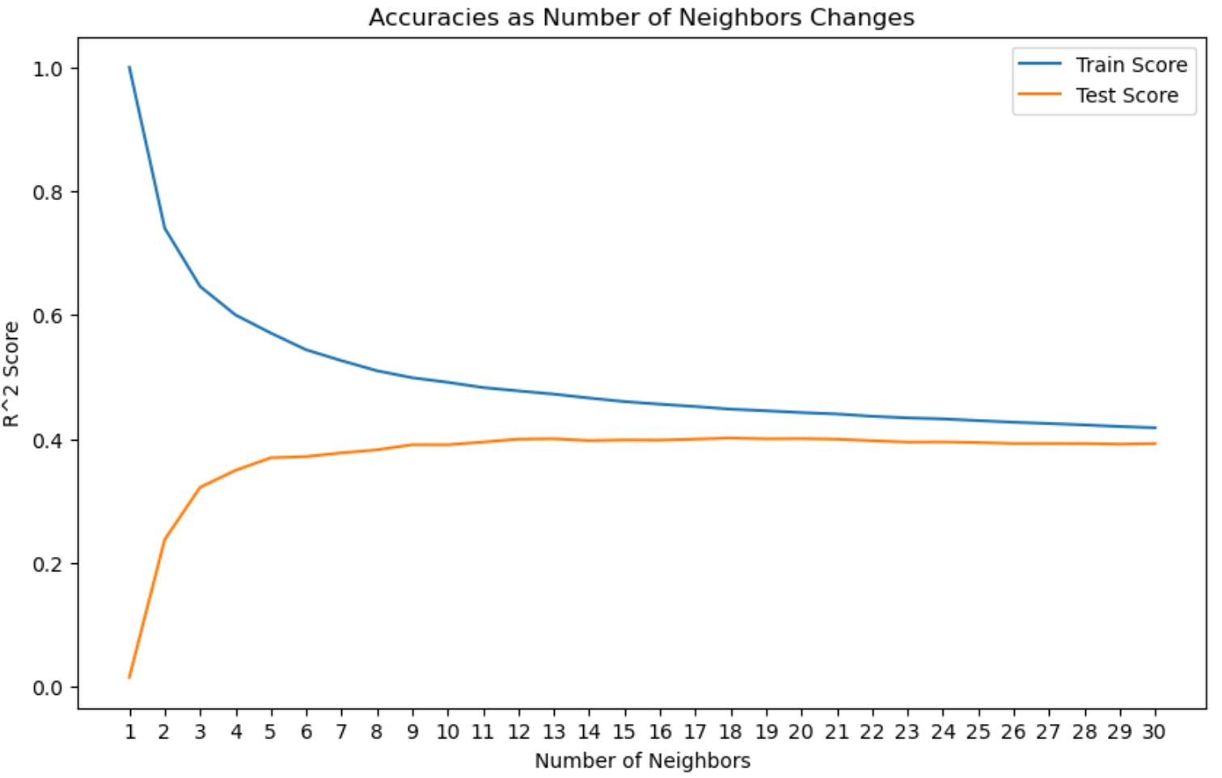
Decision Tree and KNN Regressor Are Superior, but Not Ideal, Models for Our Data
Linear Regression
10 Independent Features
Incl. Outliers: -43%
Excl. Outliers: 15%
Decision Tree
54 Independent Features
After excluding outliers:
depth = 7
Incl. Outliers: 25%
Excl. Outliers: 45%
?
KNN Regressor
54 Independent Features
After excluding outliers:
n_neighbours = 10
Incl. Outliers: 49%
Excl. Outliers: 39%
?
Notes:
- Proportion of the variance in the lastPrice that is predictable from the independent features
- All percentages are for test data
- A lot of multicollinearity issues and p-values >5% for linear regression (down to 10 features)
- Tried to optimize for hyperparameter “weights” for KNN Regressor. Setting hyperparameter "weights" to "distance" (meaning that closer neighbors will have more influence on the prediction than farther ones) makes the model overfit. By default, weight is uniform (keeping it as such).

Slide 9

Let’s Dive Deeper Into KNN Regressor (Including Outliers)
KNN Regressor – What Do the Results Show?
Example:
y-test:
$650k
y-predicted:
$403k
Predicted house price is within 40% of actual house price ~50% of the time
KNN Regressor - Snapshot
54 Independent Features
After excluding outliers:
n_neighbours = 10
Incl. Outliers: 49%
Excl. Outliers: 39%
Notes:
Example:
y-test = $650k
y-predicted = $403k
The prediction is 38% below the actual, thus it falls in the second bucket.
25% of all houses fell into the second bucket
This is based on test data (~3000 samples)

Slide 10

Housing Price Predictor App
Planning to use to develop an interactive web app
A number of features, out of the 54, will be set to default values
Will allow users to select a few main features (number of bedrooms, living area square footage, year built, etc.)
Clicking “Prediction” button will display the housing price estimate
Predict
Notes:
Overall, I would expect a higher accuracy score from the model, perhaps closer to 70-80%. It appears that we have a plenty of relevant independent variables accessible to us. The only model anywhere remotely close to my projection is decision tree regressor on 124 independent variables (before removing outliers, so on all 15,171 rows of the data).

Slide 11
Elements of Technology and Human Touch Will Determine Housing Prices
Housing price determination is art and science – a model we currently developed cannot replace Jen and her team, but can work in tandem with them
Notes:
Jen might have not provided us with all of the features taken into account (such as local regulations, future trends, etc).
Subjectivity of the matter - Real estate professionals interact directly with buyers and sellers, allowing them to understand their preferences, needs, and motivations. This human element is crucial in negotiating deals and finding the right match between buyers and properties.

